Slide 1


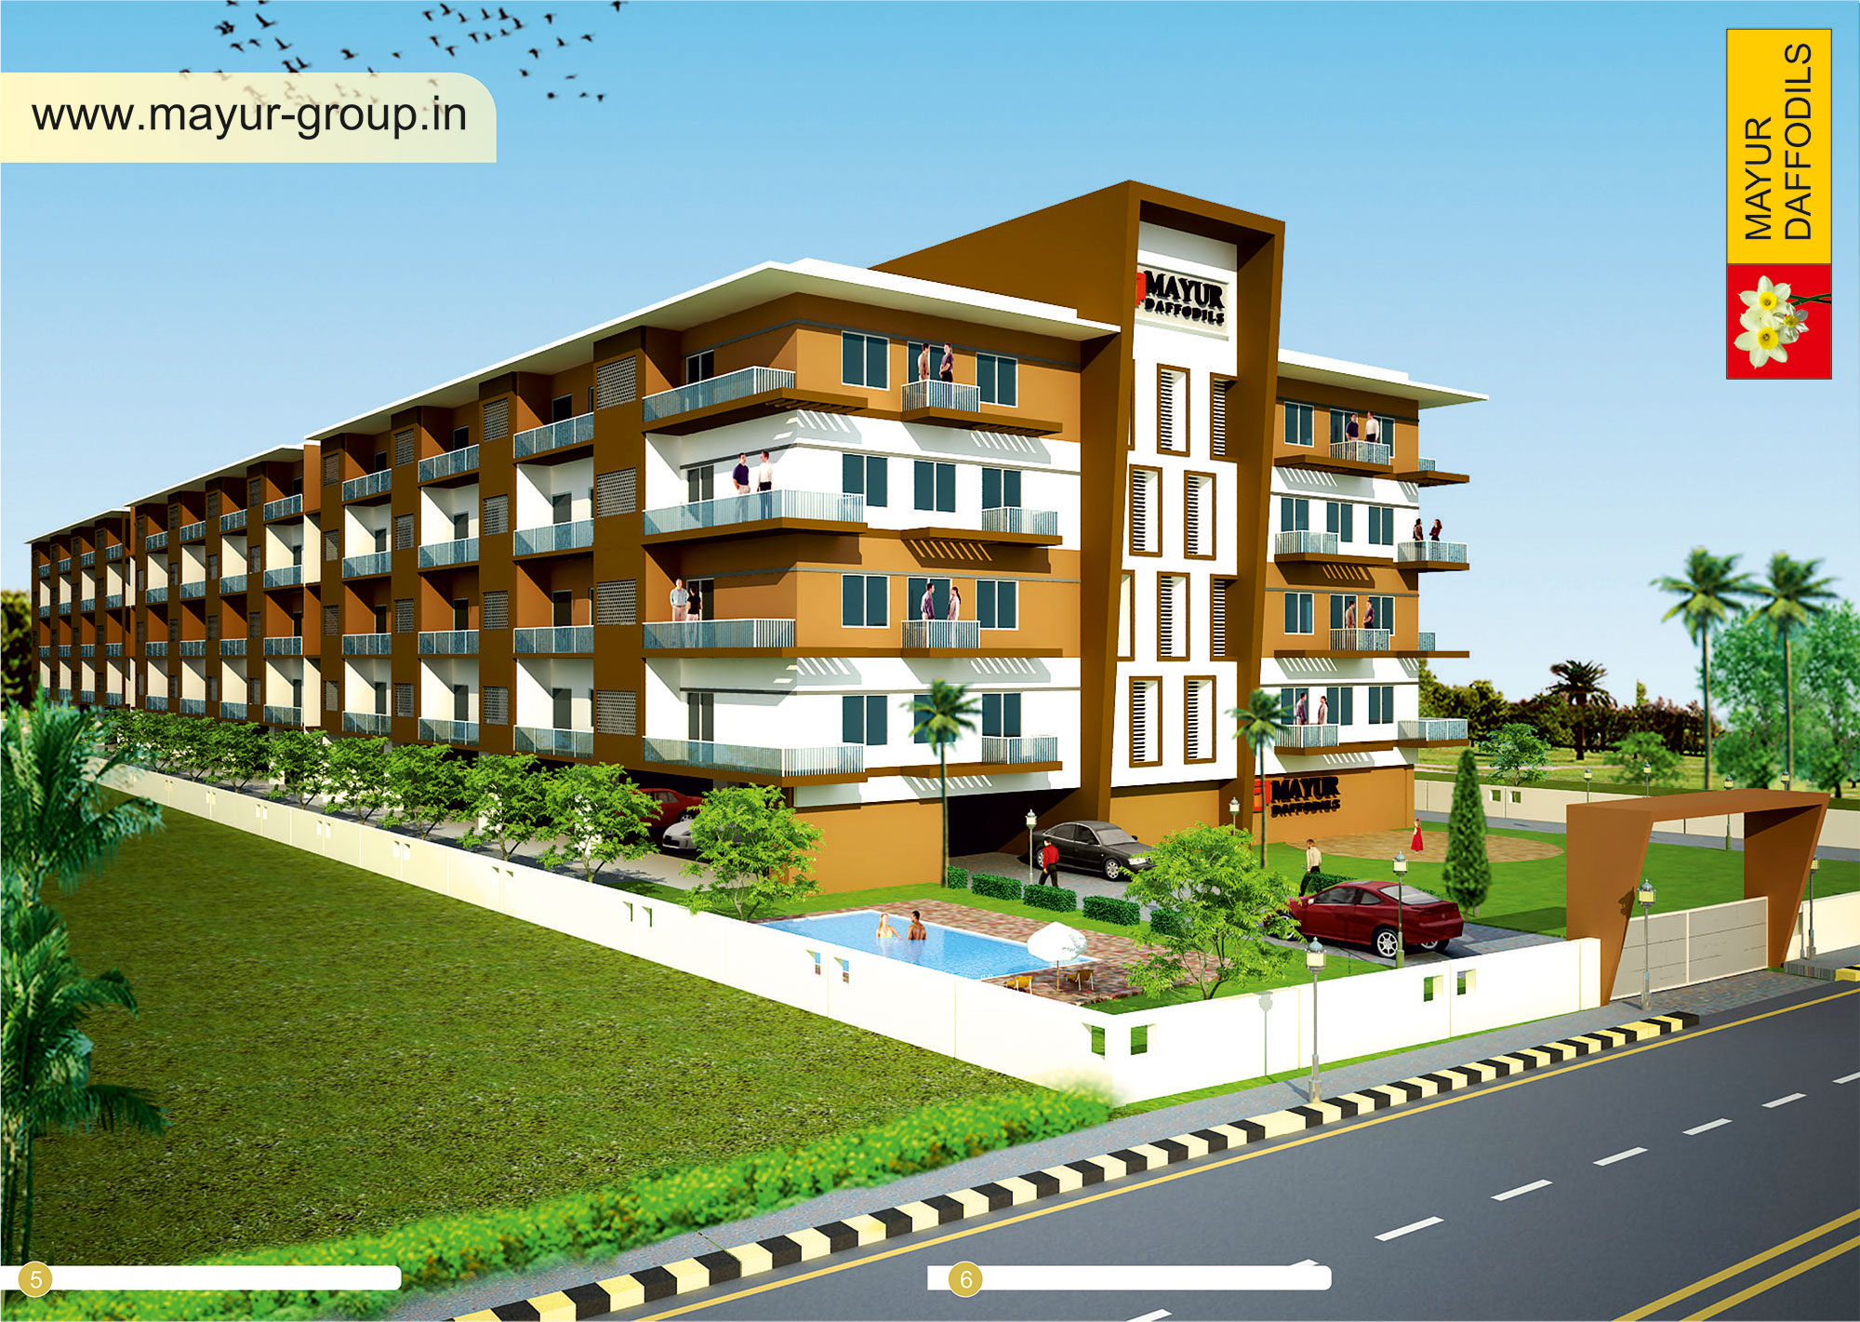
VANCOUER DAFFODILS
Experience the Brookside lifestyle
@ Vancouer Daffodils

Slide 2

Vancouer Daffodils, an exclusive 96 flats apartment coming up in Sarjapur. Daffodils is the ideal combination of unique natural surroundings with luxury and tranquillity for all those who would like to be close to Nature.
A record of not mere construction, but creation of complete comfort and pleasures of living, well-designed, fully-equipped residential apartment with the latest amenities and facilities integrated in a holistic manner. Our aim to create elegant spaces in this desirable locale to cater to the city’s rising expectations.
Daffodils is blessed with a salubrious climate, gardens, natural lakes, architectural landmarks, Well connected to the IT hubs – Electronics City, ITPL and proposed SEZs
Close proximity to major IT &manufacturing companies like Exide Industry, TVS, Titan, Ashok Leyland, Biocon and Infosys among others
Narayana Hrudayalaya, Sparsh, Live 100 and Sri Raghava Children’s Hospital are in close proximity
Prestigious educational institutions offering world-class education like Indus International School, DPS, TISB,
Greenwood School and Harvest International School
Beside Indus international school

Slide 3
OVERVIEW
AREA : 2BHK: 1205 sft
1BHK studio room: 980sft
LOCATION: Sarjapur-Attibele Main Road Near to
proposed Infosys campus and beside
Indus International School
PRICE: 2BHK: 3576670*
1BHK: 2997520*
POSSESION: Ready to move in by OCT 2014
Approval: bmrda
BANKS: lic, axis , icici & all nationalised bank

Slide 4
luxury Amenities
Children's Play Area
Gym (Ladies - Gents)
24x7 Security with Intercom Facility
Power Backup- Generator
Table Tennis Court
Shuttle Court (Open Area)/Basket ball
Party Hall / Multi Purpose/Meditation hall

Slide 5
Indoor Games
Basket Ball Court
Lap Pool
Club House
Meditation Hall
Jogging track

Slide 6
Specification - Daffodils
Structure: RCC Frame Structured with 6" Solid Block. | Flooring: Vitrified Tiles for living, Bedroom, Dining and Kitchen. Anti Skid-Ceramic Tiles for bathroom and 7"0 high wall dadoing. | Doors & Windows: Main: Teek Wood Frame With Teek Wood Panel door. Internel: Flush Door Windows: UPVC three Track windows with safety grill.
Kitchen: 30mm Granite slab with stainless sink and drain board with two feet doddoing | Toilets: Sanitary Fitting:Parry ware/Jaguar CP Fitting:Parry ware/Jaguar | Wiring & Switches: ISI Brand Finolex/Anchor Wire/GM/Lisha/Anchor Modular switches as per Drawing.
Painting: Two Coats of Putty and 2 Coats of Asian Emulsion Paints with roller finish for internal walls and one coat for external walls | Water: Sufficient Bore Wells with over head water tank. | Power Backup/Generator: Kirloskar Generator Power Backup for each villa and Comman Area.
Gym: Well Equipped Gym for Ladies/Gents. | Car Parking: Seperate Car Parking for Guest | Security: Intercom Fecilites provision for each villa & 24 Hours Security.

Slide 7
Highlights:
Wipro Corporate Office – 16 KM
Sarjapur Circle – 5.5 KM
Narayana Hrudayalaya – 12KM
Electronic City – 16 KM
ITPL – 22 KM
Outer Ring Road – 18 KM
Forum Mall – 28 KM
Educational Institution
Sunrise International School
Christ Academy
Indus International School
Hospitals
Vimalaya Hospital
Narayana Hrudayalaya
Sparsh Hospital
Agarwal National Hospital
Ramakrishna Health Care
Hotel & Clubs
Hotel Guest Line , Crown Plaza
Gold Coin Club , La-Classic
DECATHLON sports

Slide 8
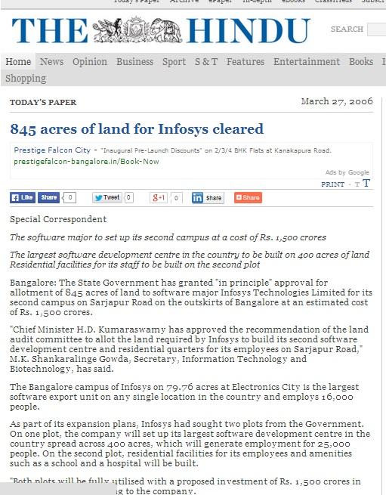

Slide 9
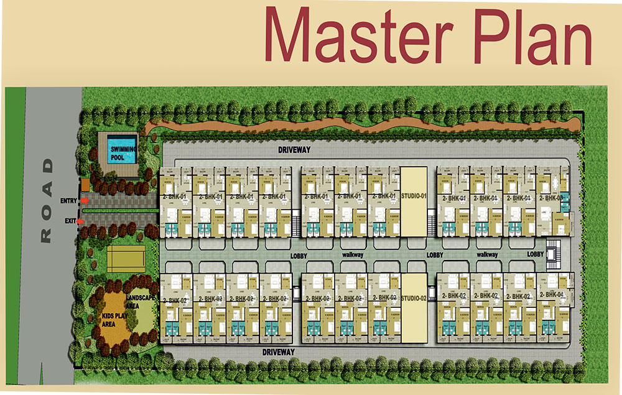

Slide 10
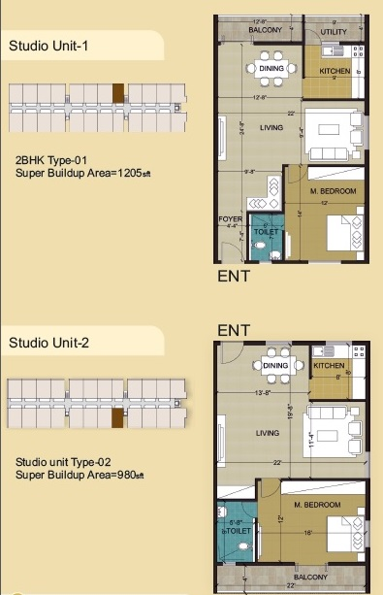
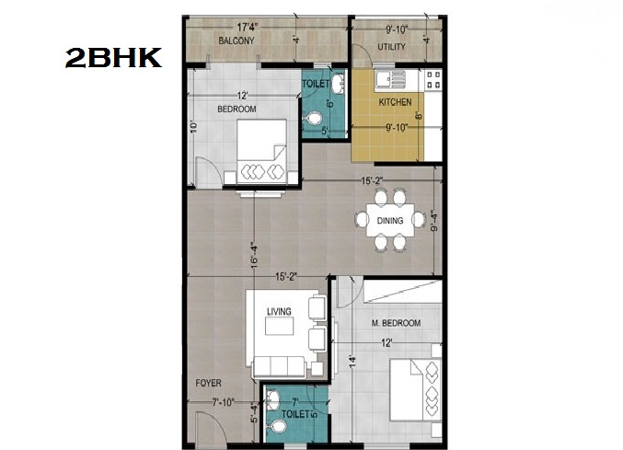

Slide 11
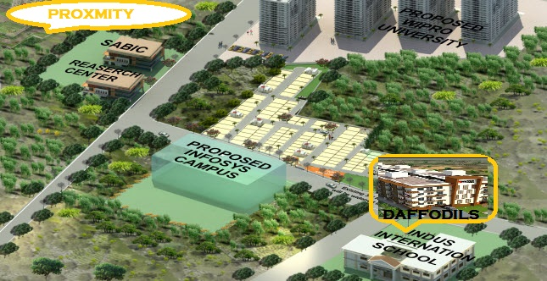

Slide 12



VANCOUER GROUP
Aruna
Ph: 7795984626
Aruna.vancouer@gmail.com

